Slide 1
A learning tool for LR(0), SLR(1),LR(1),LALR(1) and LL(1) parsers

Slide 2
Implemented using JDK 11, JavaFx SDK and GraphViz

Slide 3
General workflow
Process the grammar given as input
Generate the automaton and it’s transition table(for LL(1) this is not necessary)
Generate the parsing table and detect conflicts
Take a string as input and tokenize it
Run a bottom-up ( or top-down ) syntactic analysis
If the string is accepted create the parsing tree

Slide 4
Grammar processing
Only Context Free Grammars are permitted
Tokens (non-terminals and terminals) are determined using Regular Expressions
Only one production per line
The first non-terminal to appear is the start symbol

Slide 5
How are the graphs drawn ?
Using the dot language provided by GraphViz
Firstly, the dot description of the graph is generated
Call the dot executable with this description as input, thus creating a new process
The new process will create the image. The current process has to wait for this new process to complete.

Slide 6
Automata representation
Items are extensions of production rules
A state is a set of items
An edge is a triplet consisting of two references to the initial and final states and the token via which the transition is done.
Automata = a set of states + a set of edges

Slide 7
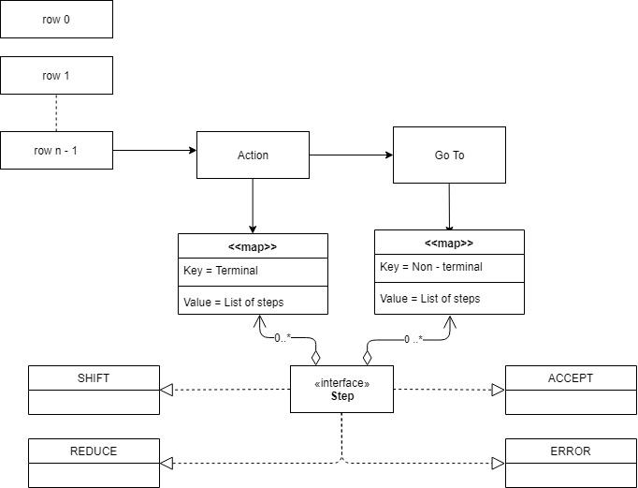
LR Parsing Tables
Each row is associated with a state in the automaton and has an Action and Go To part. Conflicts exist in a cell if the size of the step list is greater than one.

Slide 8
LR(0)
Augment the grammar.
Add the state that is the closure of S’ -> .S to the automaton and set it as unprocessed.
For each unprocessed state increment the position of the dots in the items of said state and create new states if needed. Set the new states as unprocessed .Set the current state as processed.
Build the LR(0) parsing table.

Slide 9
FIRST set
FIRST(X) = set of all substrings of length at most 1 that begin the substrings derivable from X.
1 – concatenation = just like normal string concatenation, except we consider only the first symbol. Can be extended to sets of strings as well.
Use two maps F and F’ to store the values of the FIRST sets from the current and previous iteration. Whenever the maps are equal the algorithm stops.
At each iteration for each production N -> X₁ X₂ … X_{n} add F’(X₁) *₁ F’(X₂) *₁ … * ₁ F’(X_{n}) to F(N)

Slide 10
FOLLOW set
FOLLOW(X) = set of strings of length at most 1 that can appear immediately to the right of X.
Similar to FIRST two maps FL and FL’ are used
At each iteration for each production N -> X₁ X₂ … X_{n} add FIRST(X_{i+1}) *₁ FIRST(X_{i+2}) *₁ FIRST(X_{n}) *₁ FL’(N) to FL(N)

Slide 11
SLR(1)
Automaton is the same
When building the parsing table add ACCEPT and REDUCE only to terminals which belong to FOLLOW of left-hand side of the rule from the complete item in the state.
Smaller number of REDUCE actions -> Less conflicts and faster error detection

Slide 12
LR(1)
Add lookahead to items and changed closure procedure
Augment the grammar and add the closure of S’ -> .S, $ as the initial state and set it to unprocessed.
Create new states in a similar manner to LR(0) and set them as unprocessed.
When all states are processed the algorithm stops.

Slide 13
LALR(1)
Compute the LR(1) automaton and group the equivalent states.
Replace all the states in a group with their reunion.
Automaton has same number of states as LR(0) and it is more memory efficient.
It is more powerful than SLR(1)

Slide 14
Bottom - Up Syntactic analysis 1
Linear time
Parsing table must be computed first
Uses a stack
A step in the algorithm has the following configuration:
The current elements in the stack
The remaining input
The action taken : SHIFT, REDUCE, ERROR or ACCEPT
Output : The shifting state in case of SHIFT and a production for REDUCE

Slide 15
Bottom – Up Syntactic analysis 2
Initially, append “$” to the input and add state 0 to the stack
Possible actions:
SHIFT -> push the current terminal and the shifting state to the stack and advance one position in the input
REDUCE -> let N be the left-hand side of the rule. Pop the stack twice and add N and the state from N’s cell to the stack.
ACCEPT or ERROR -> stop

Slide 16
LL parsing table
Implemented as a hash map where the key is a (Non-Terminal, Terminal) pair and the key is a set of Production Rules.
If there is more than one production in a cell then there exists a conflict in that cell.
An empty cell is considered to be an error.

Slide 17
LL(1) parsing table construction
For each production N -> RHS in the grammar:
For each terminal T in FIRST(RHS) add N -> RHS to cell (N,T)
If FIRST(RHS) contains the empty string then do the same for FOLLOW(N)
If FOLLOW(N) contains the empty string then add N -> RHS to cell (N, $)

Slide 18
Top – Down Syntactic Analysis 1
Similar to bottom-up analysis, it is linear and uses a stack.
Configuration:
The stack
The remaining input
Action : EXPAND, MATCH, ACCEPT and ERROR
Output : production used for EXPAND and the terminal for MATCH

Slide 19
Top – Down Syntactic analysis 2
Append “$” to the input then push “$” and S to the stack.
If the top of the stack is a non-terminal then EXPAND: pop the stack and add the left-hand side of the rule in the parsing table in reverse to the stack.
If the top of the stack equals the current terminal in the input:
If the top is “$” then ACCEPT
Else MATCH : pop the stack and advance in the input

Slide 20
Parsing Trees
Each node contains a token
The root will always be the start symbol
Leaves are the terminals in the input string
Right – most derivation tree for LR and left – most derivation for LL
May need to go up the tree if the current node does not match the left-hand side of the rule

Slide 21
